Slide 1
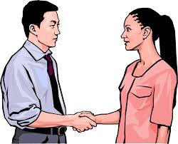
How are you?

Slide 2

I am happy.

Slide 3

I am sad.

Slide 4

I am ok.

Slide 5

I am tired.

Slide 6

I am angry.

Slide 7
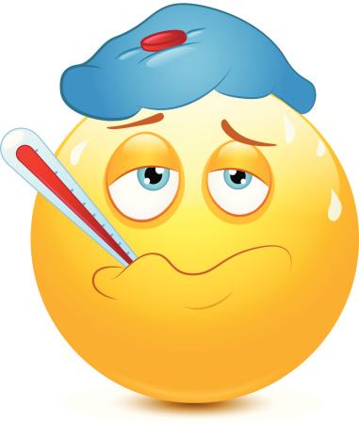
I am sick

